Slide 1
Single-Molecule Localization Microscopy (SMLM)
Genome 575: Fundamentals of Biomedical Instrumentation
Brian Beliveau

Slide 2

First off…
https://pbs.twimg.com/media/EHZ5xFnWoAASVvx.jpg

Slide 3

Second off … evals (15 mins)
https://www.repumint.com/wp-content/uploads/2018/05/Yelp-reviews.jpg

Slide 4
Recap from last time
Objectives have important properties including magnification, working distance, and immersion medium
Numerical Aperture (N.A.) determines the resolution of the imaging system
Point Spread Functions (PSFs) can be used to QC an objective/imaging system
The PSF is anisotrpic and narrower in the XY (lateral) than Z (axial) dimension

Slide 5
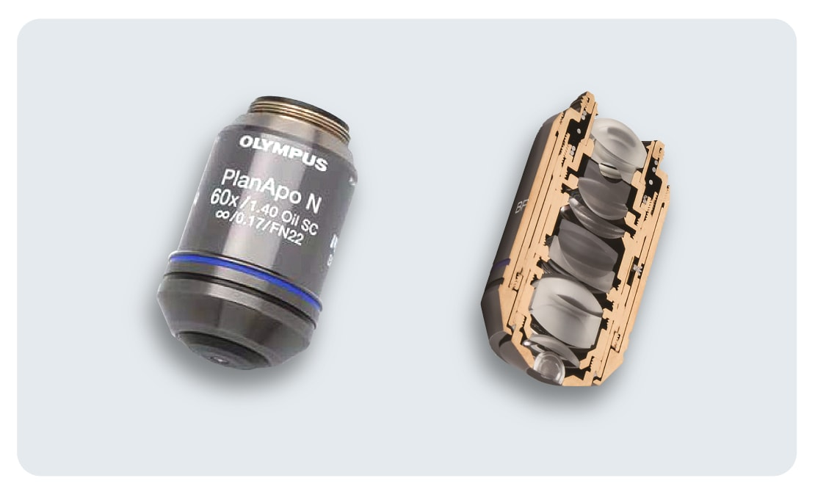
Objectives revisited
https://www.olympus-global.com/csr/social/learning-about-science-and-the-future/technology/lens02/images/index-03.png

Slide 6
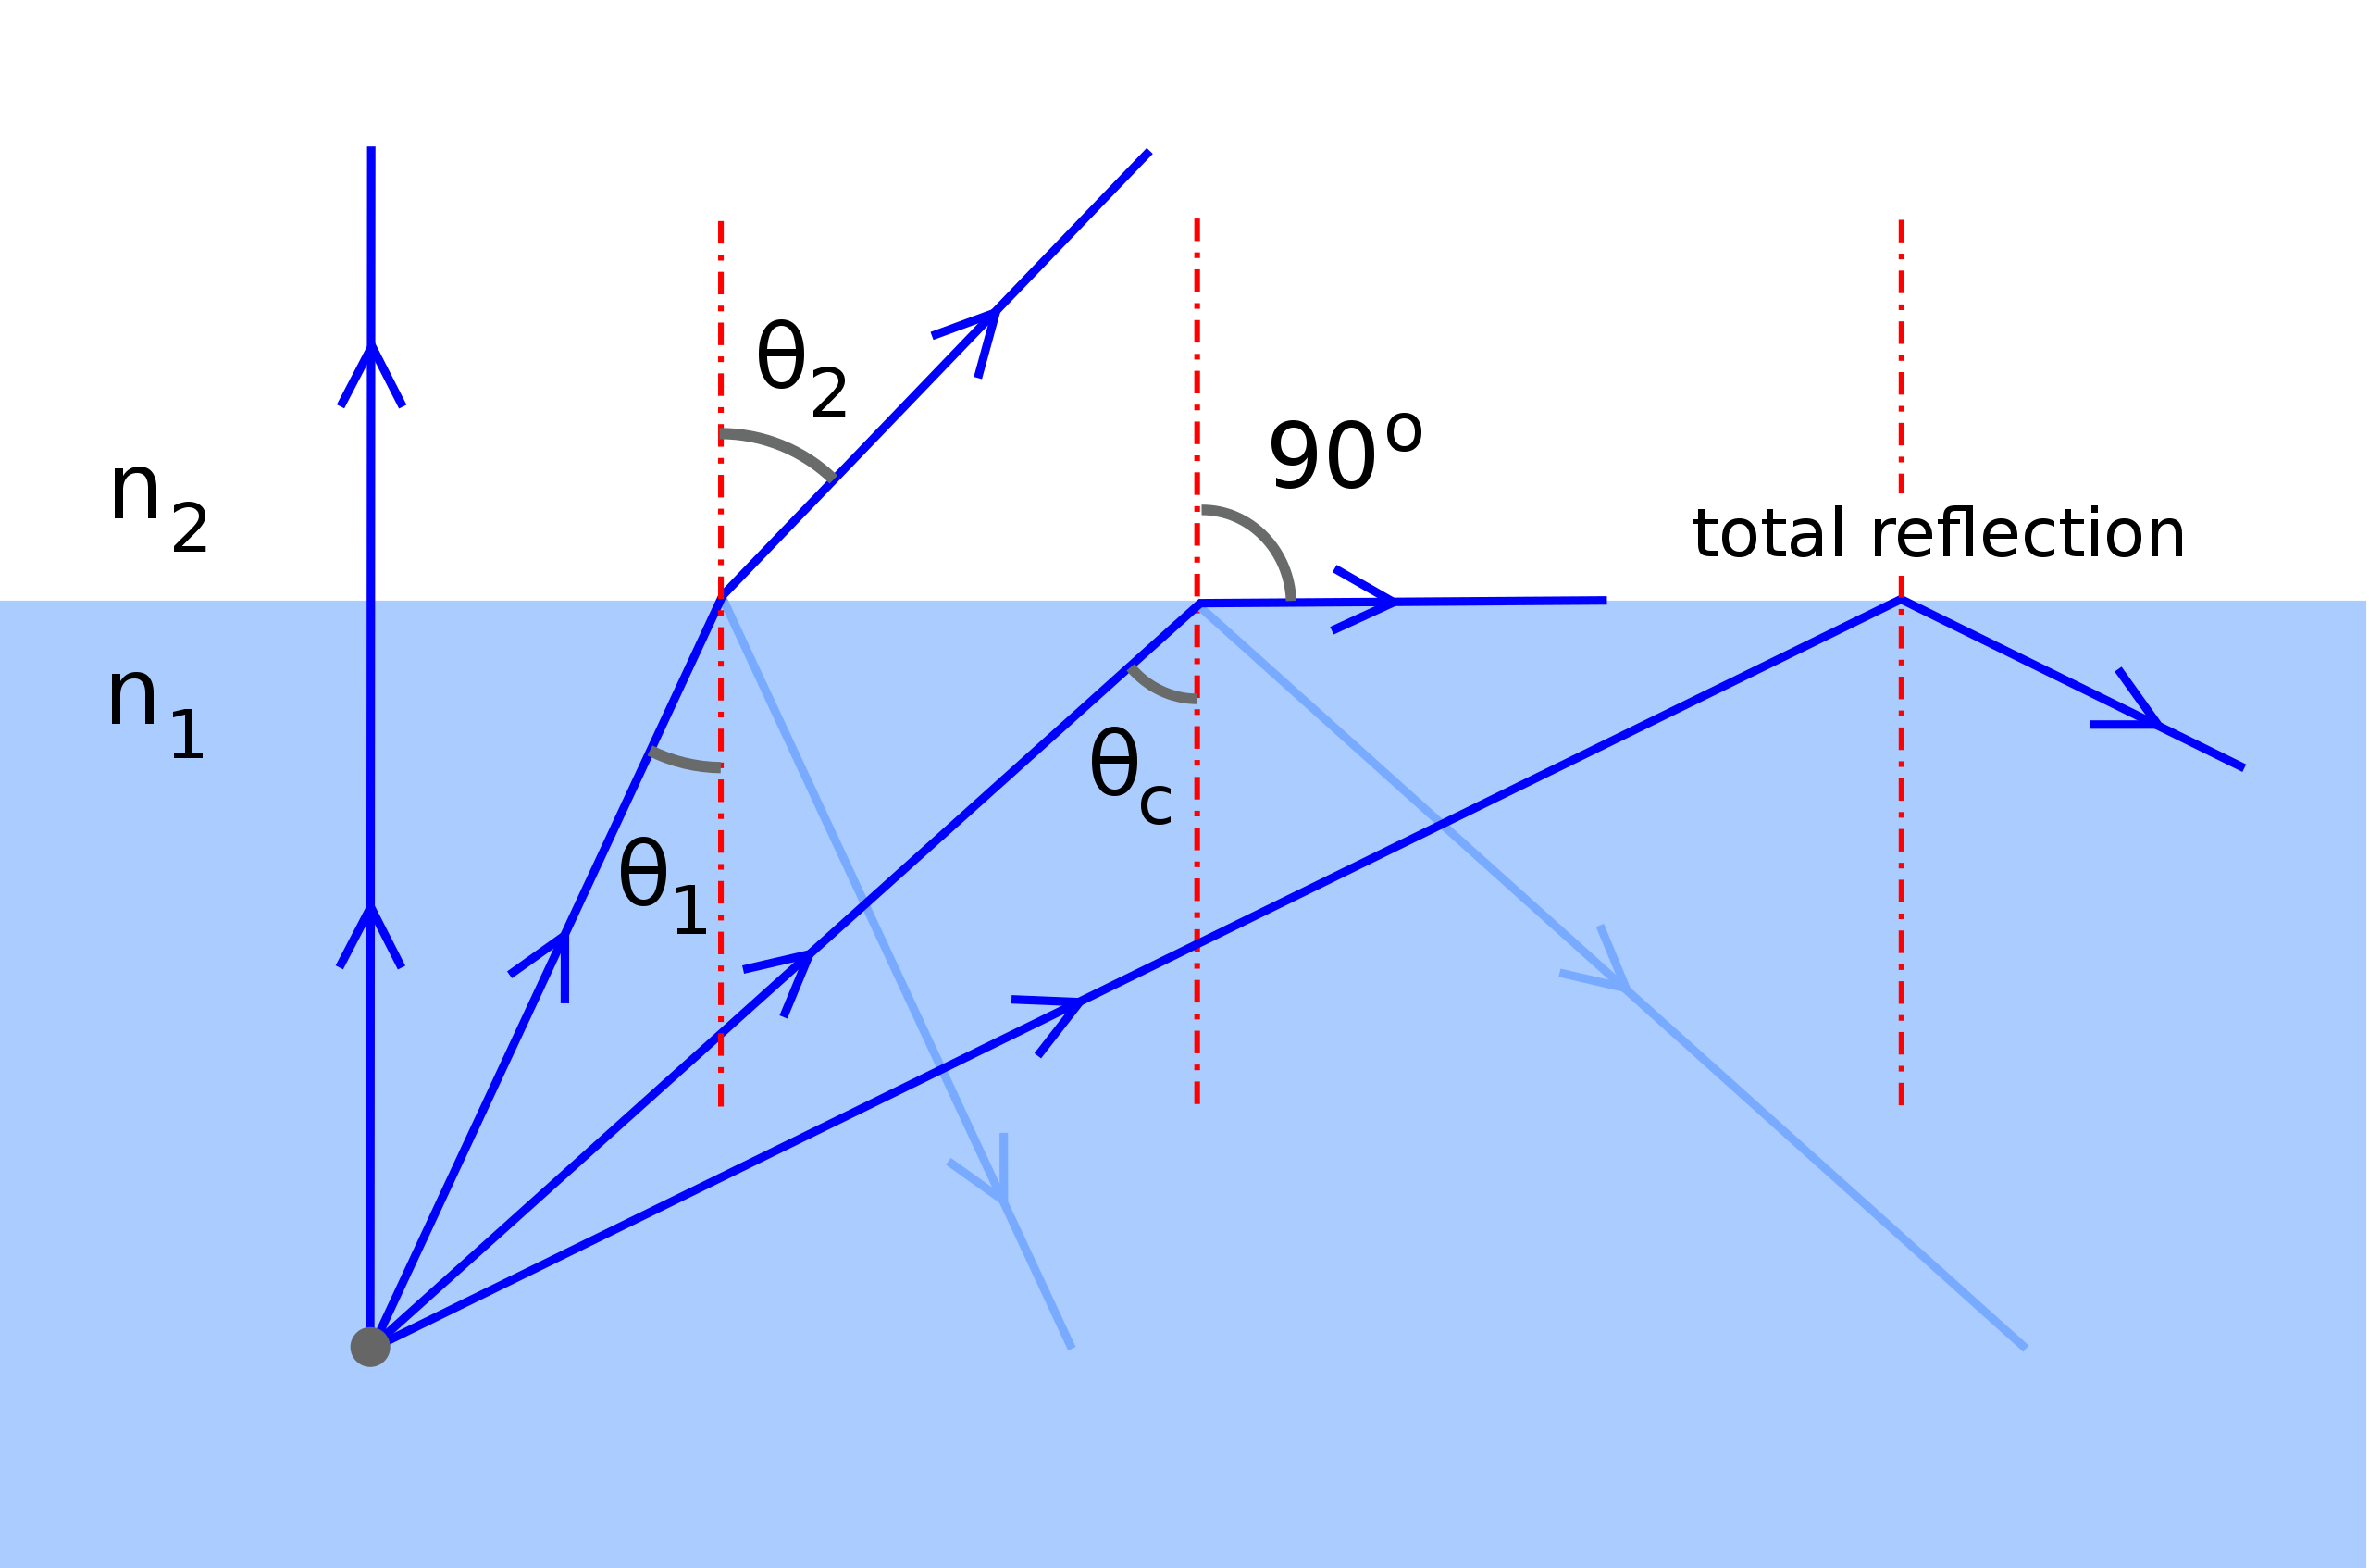

Reflection revisited
When moving to a medium of lower refractive index, incident light at an angle > the critical angle will be totally internally reflected
Total internal reflection generates an evanescent wave at the interface
https://upload.wikimedia.org/wikipedia/commons/thumb/8/8a/ReflexionTotal_en.svg/2560px-ReflexionTotal_en.svg.png,

Slide 7
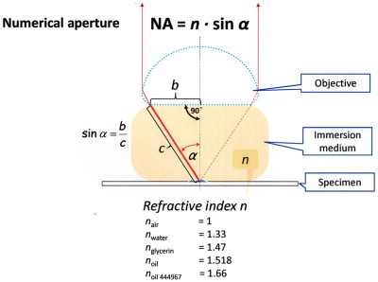
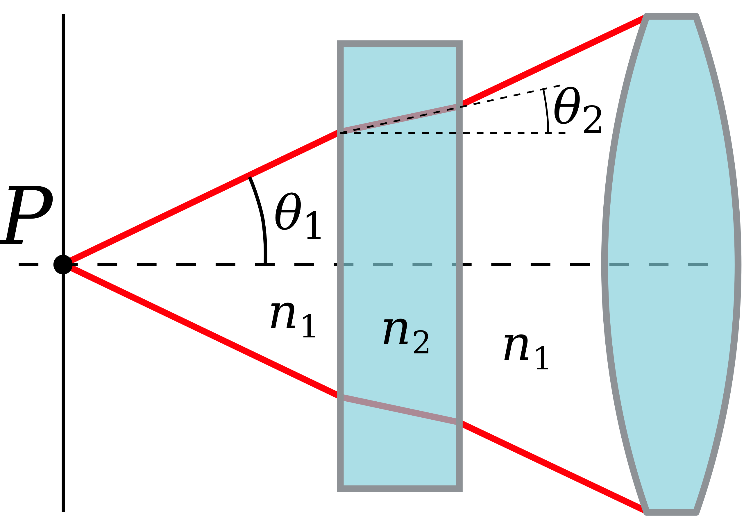
Refraction revisited
https://upload.wikimedia.org/wikipedia/commons/thumb/4/4c/Numerical_aperture.svg/1200px-Numerical_aperture.svg.png, https://ars.els-cdn.com/content/image/1-s2.0-B9780124077614000038-f03-08-9780124077614.jpg

Slide 8
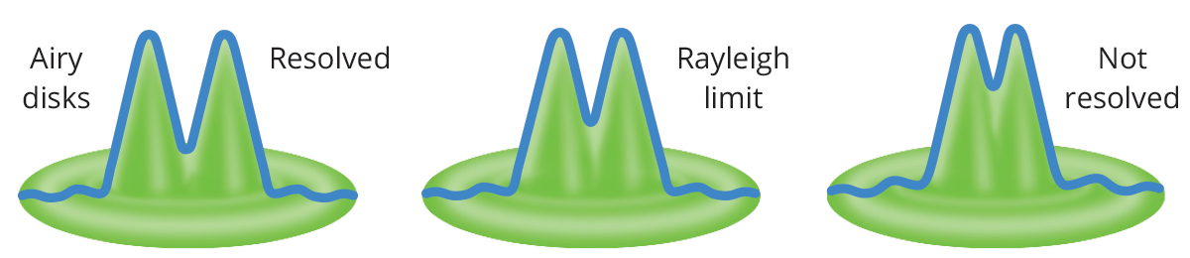
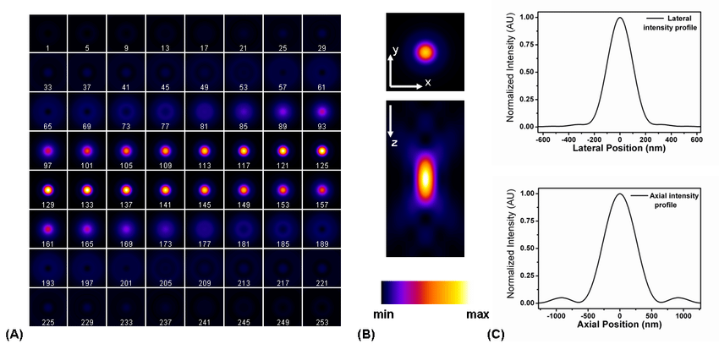
Resolution revisited
Rayleigh criterion: D = 1.22 * 𝝀 / N.A. (for 520 nm, N.A 1.45: 437.5 nm)
Abbe’s formula
Lateral (XY): d = 𝝀 / 2 * N.A
For 520 nm, N.A. 1.45:
d_{XY} = ~180 nm
https://www.opto-e.com/basics/media/basics/optics/optics26.png,

Slide 9
How do we overcome the resolution limit?
Increase the information we obtain about the PSF
SIM (structured illumination microscopy): patterned illumination at multiple angles -> more info in Fourier space
Change what you are sampling
STED (Stimulated Emission Depletion): use 2 lasers to restrict illumination to area smaller than airy disc
ExM (Expansion Microscopy): Make your sub-diffraction object physically bigger
Use Estimation (and assumptions) to infer information about emitters: SMLM (Single-Molecule Localization Microscopy)

Slide 10
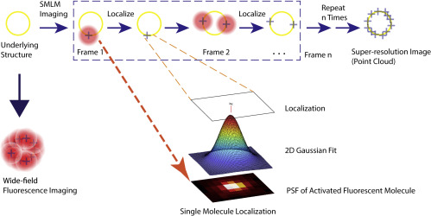
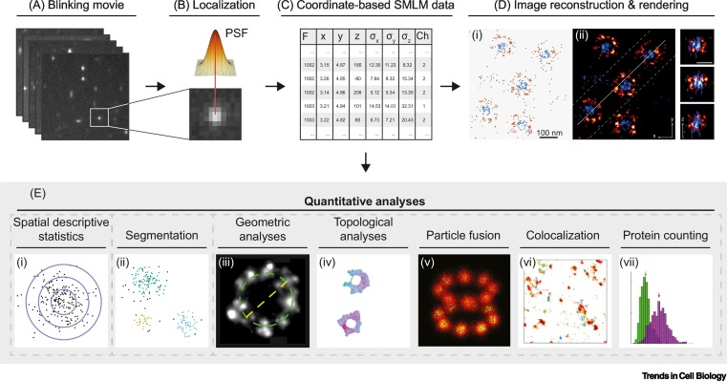
SMLM: basic principles
https://ars.els-cdn.com/content/image/1-s2.0-S266638992030043X-gr3.jpg, https://els-jbs-prod-cdn.jbs.elsevierhealth.com/cms/attachment/8ef80472-1ec7-461e-a32f-930844e9df6d/gr1.jpg

Slide 11
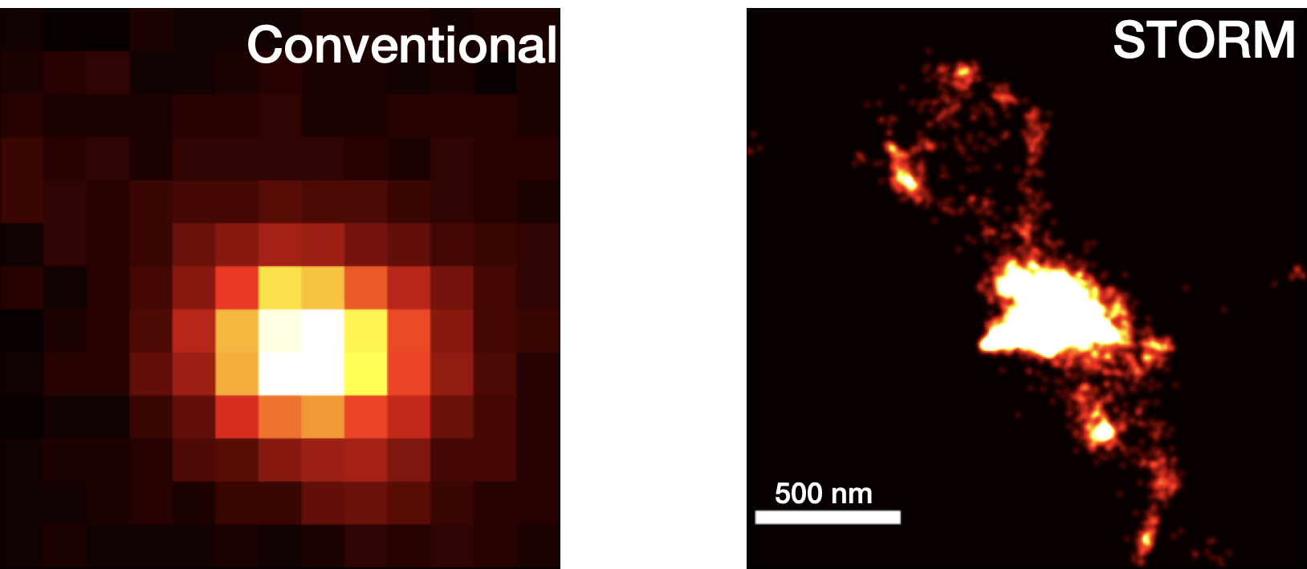
SMLM: an overview
“Time-lapse” movies of fixed or live samples, typically 5k–50k frames
Localization precision: ~5–20 nm (XY), 15–50 nm (Z)
Resolution = ~2.35 x precision: ~12–50 nm (XY), ~50-120 nm (Z)
Reconstructions composed of 100s – 10000s of individual localizations
Beliveau et al. Nat Comms 2015

Slide 12
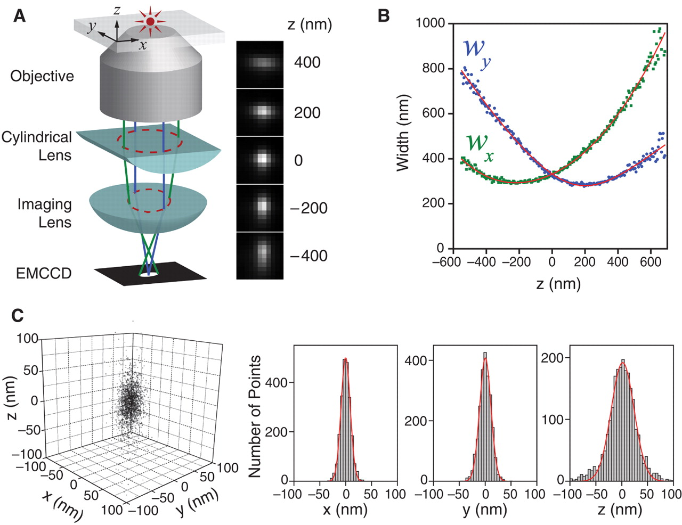
How do we localize emitters in 3D?
A cylindrical lens distorts the PSF differently in planes above/below the focal plane
Information is gained about Z, but lost about XY
https://www.science.org/cms/10.1126/science.1153529/asset/f4410887-bdbb-43f2-ade0-db627d2a9b04/assets/graphic/319_810_f1.jpeg

Slide 13
What are instrumentation challenges for SMLM?
Detector sensitivity
PSF sampling
Stage drift (XY)
Stage drift (Z)
Speed/throughput
Data transfer / size
Sample integrity
Buffer conditions (pH!)
Bleaching / triplet state transitions
Cost
Mechanical stability
Objective / immersion
Selective illumination/collection (SNR)

Slide 14
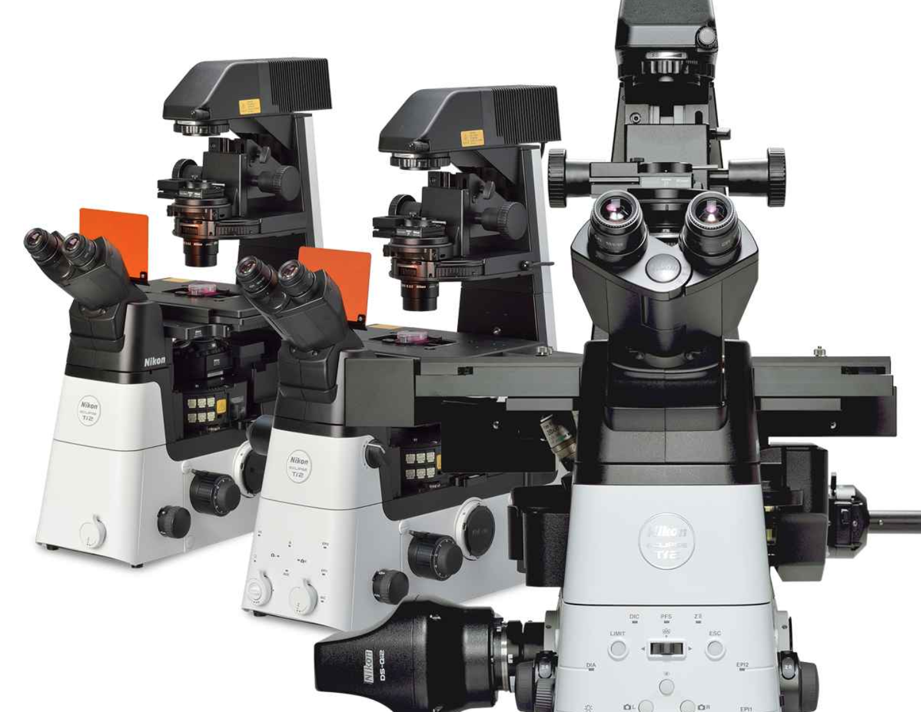
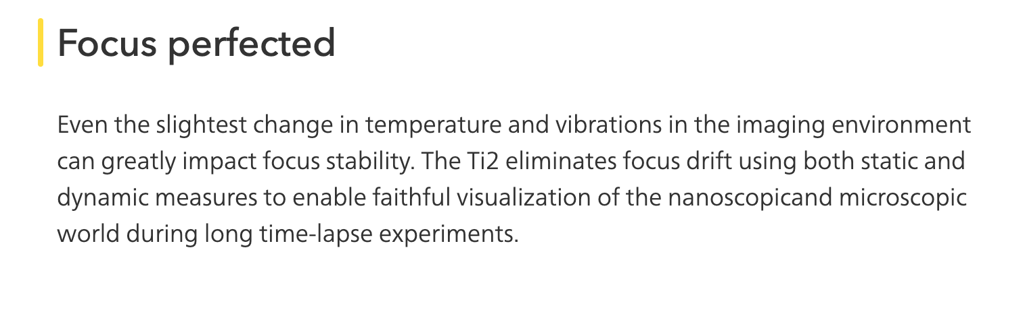
Challenge: How do we make a focus lock?
https://www.microscope.healthcare.nikon.com/products/inverted-microscopes/eclipse-ti2-series?utm_source=MicroscopyU&utm_medium=link&utm_campaign=MicroscopyU%20Content%20Link&utm_content=Perfect%20Focus%20System%204

Slide 15
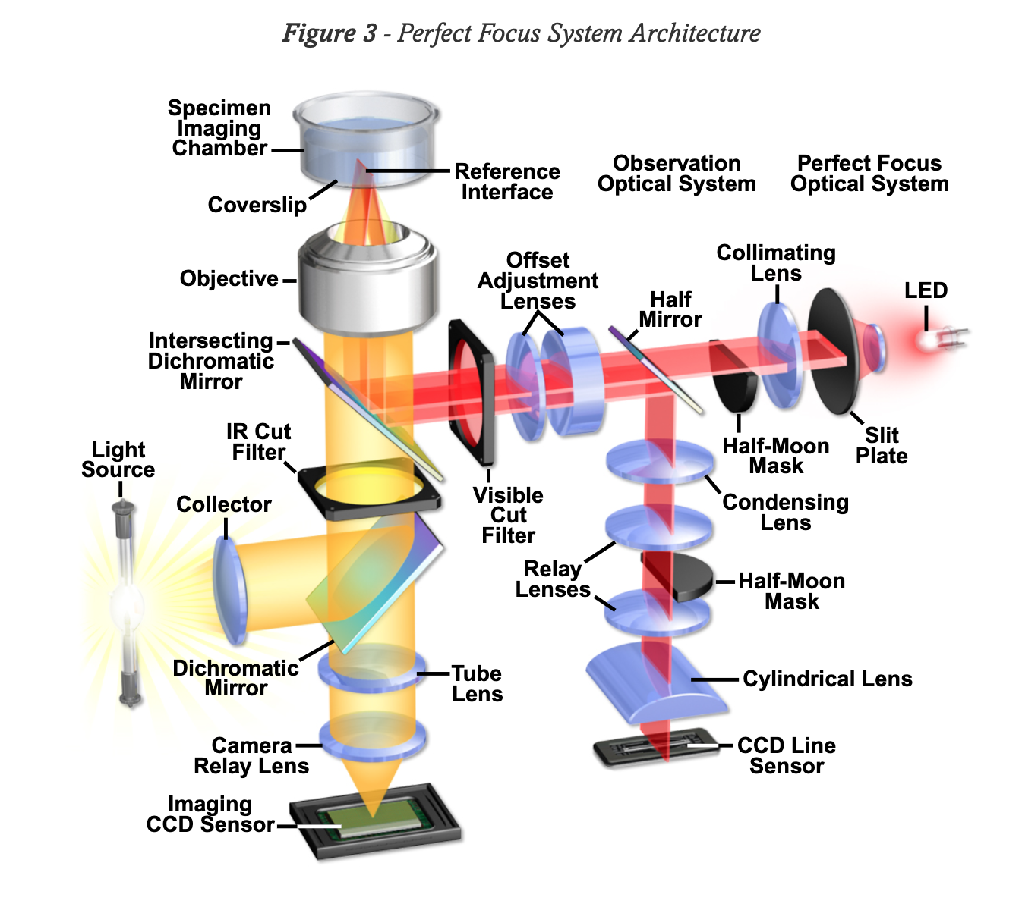
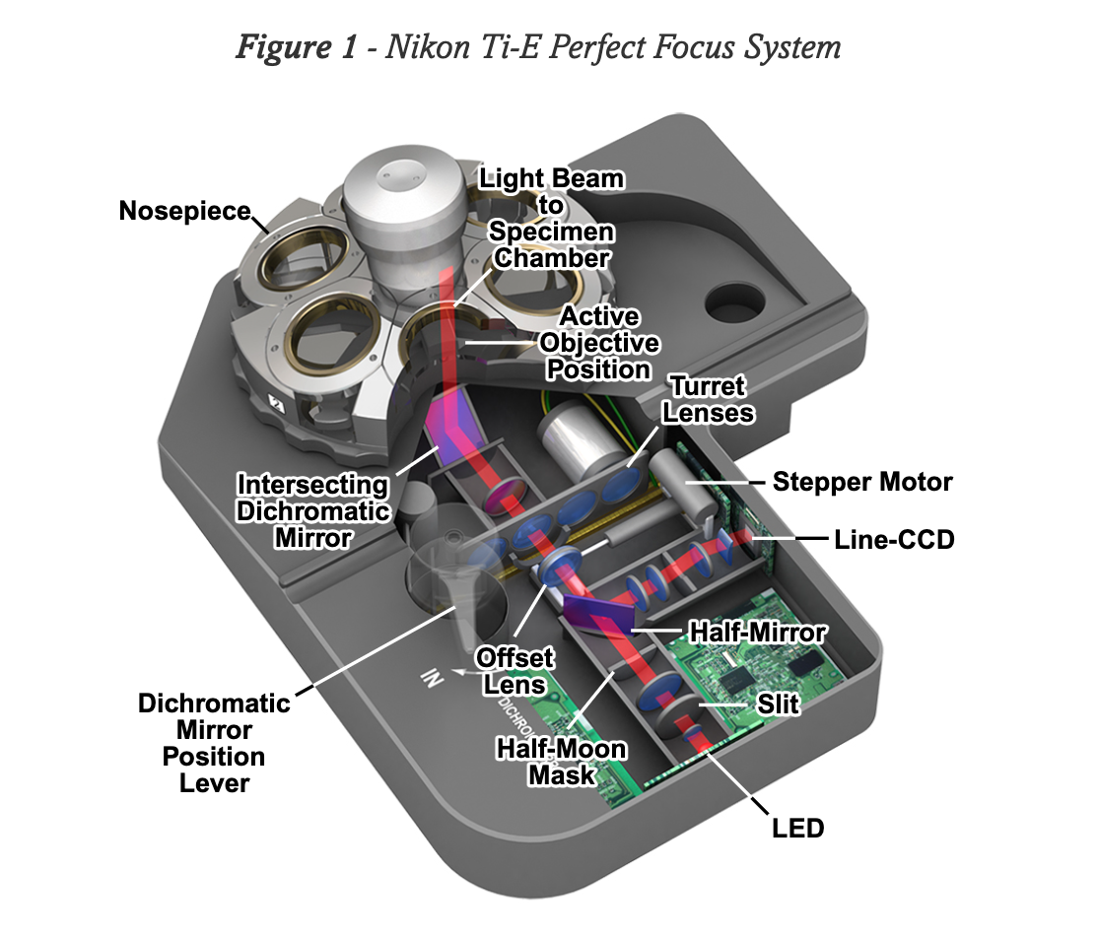
Challenge: How do we make a focus lock?
https://www.microscopyu.com/applications/live-cell-imaging/nikon-perfect-focus-system

